Slide 1


Powered by

Slide 2
Why did we make shinyMBA?
Simplify the way we do quality control (QC) by automating the tedious parts
upload xPONENT and/or Bio-Plex Manager (BPM) files and let the app do the heavy lifting
Expand participation in the QC process
Enables better QC communication and transparency
Expands QC capacity
Simple and flexible data analysis
Point and click interface
Flexibility to customize the QC parameters based on individual studies

Slide 3
shinyMBA Features
Visualize plate bead counts and MFI
Flag wells and whole plates with low bead counts and/or MFI
Track control performance over time
Flag plates with poor performing controls
Download merged datasets and summary tables
Download high resolution plots

Slide 4
Basic workflow
Load your xPONENT (.xlsx) and/or multi-tab BPM (.xlsx) files into the app
Indicating background and specific controls in xPONENT protocol aids user in plot generation
BPM files must have tabs for “FI”, “FI – Bkgd”, and “Bead Count” or they will not be accepted
Set QC parameters in the app’s modules
Interact with your data in the modules
Download QC outputs

Slide 5
Getting Started
Uploading your runs into the app

Slide 6
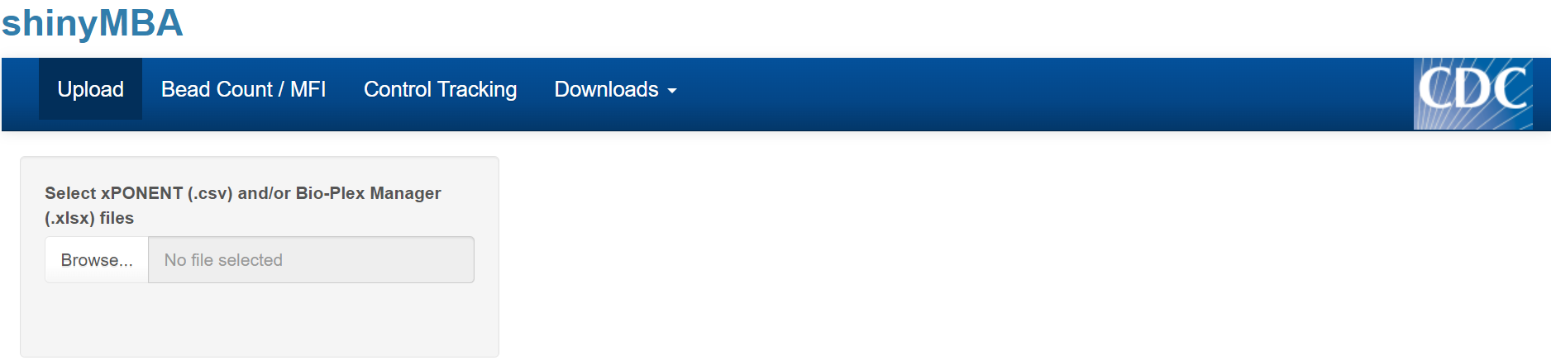
Load xPONENT (.csv) and/or BPM (.xlsx) files into the app
Click the “Upload” tab
Click “Browse…” to open the file explorer

Slide 7
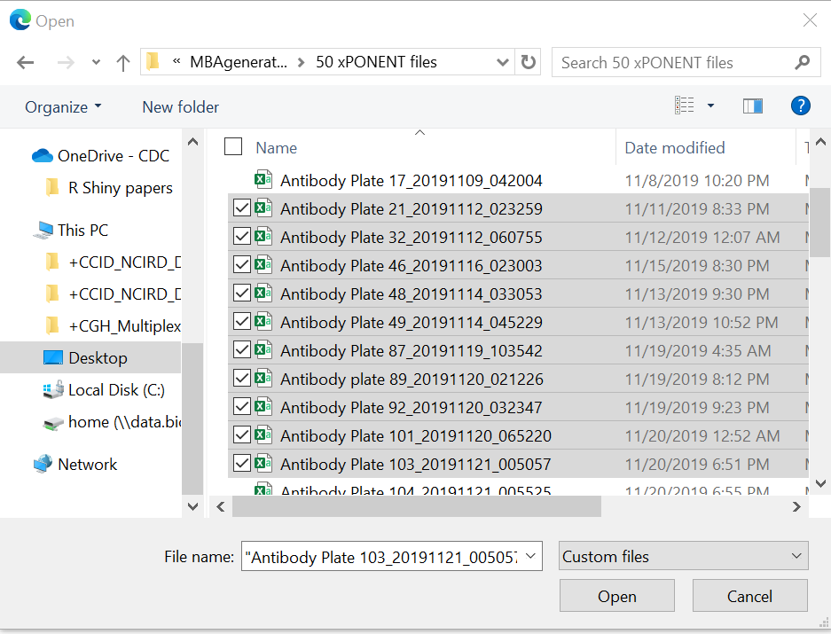
Load xPONENT (.csv) and/or BPM (.xlsx) files into the app
Click the “Upload” tab
Click “Browse…” to open the file explorer
Select the xPONENT and/or BPM files you want to load (multiple can be loaded at once) and click “Open”

Slide 8
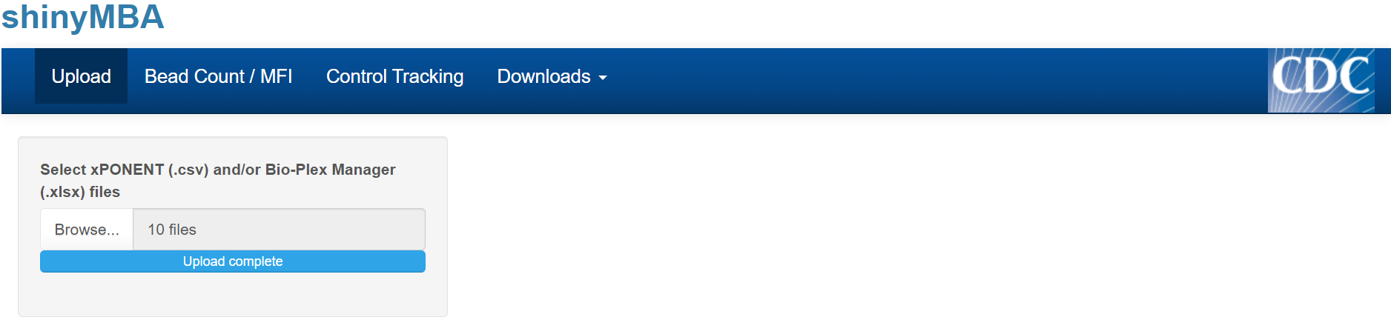
Load xPONENT (.csv) and/or BPM (.xlsx) files into the app
Click the “Upload” tab
Click “Browse…” to open the file explorer
Select the xPONENT and/or BPM files you want to load (multiple can be loaded at once) and click “Open”
Wait for the progress bar to state “Upload complete”
Begin using the app!

Slide 9
Bead Count QC

Slide 10
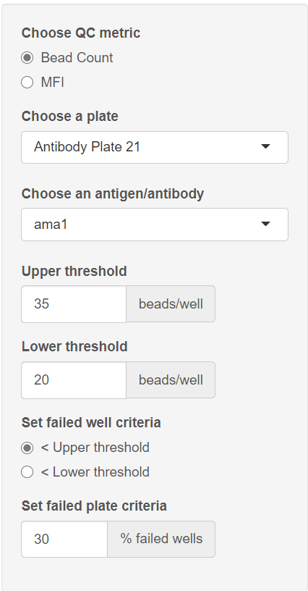
Bead Count QC: setting parameters
Click the “Bead Count / MFI” tab
Under “Choose QC metric” select “Bead Count”
Under “Choose a plate” and “Choose an antigen/antibody”, select which batch and antigen/antibody combination you’d like the app to display.
Inform the app of your bead count upper and lower thresholds
Set how the app determines failed wells
Bead counts under the upper threshold or under the lower threshold
Set how the app determines failed plates
% of wells with bead counts under the upper or lower threshold

Slide 11
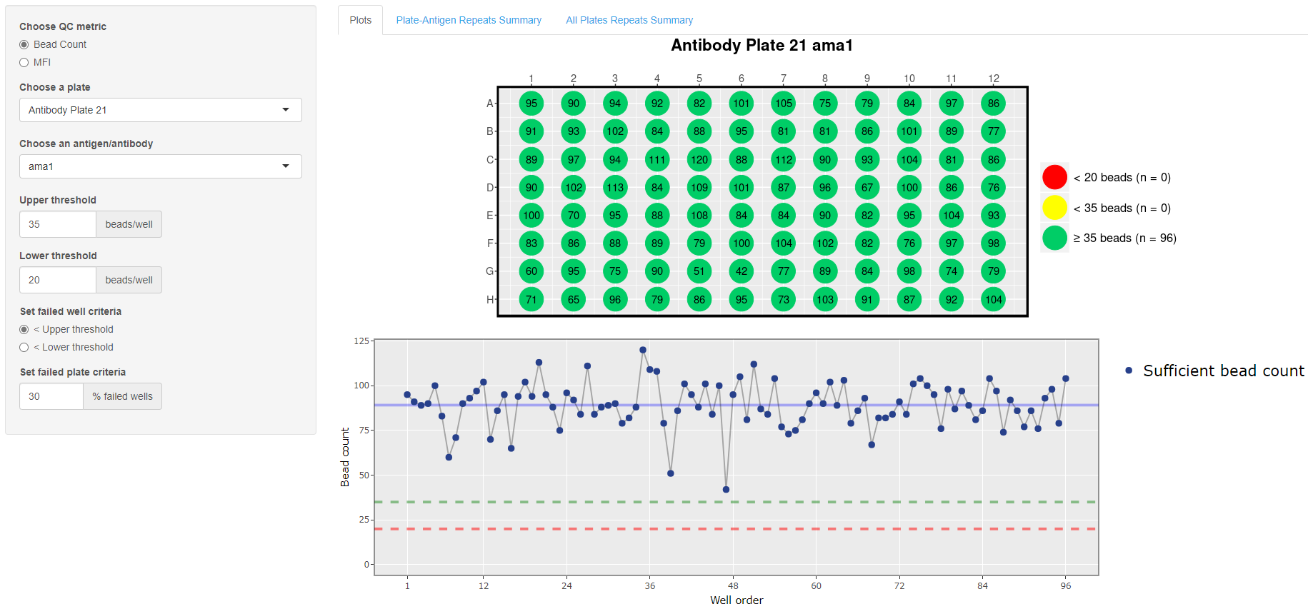

Slide 12
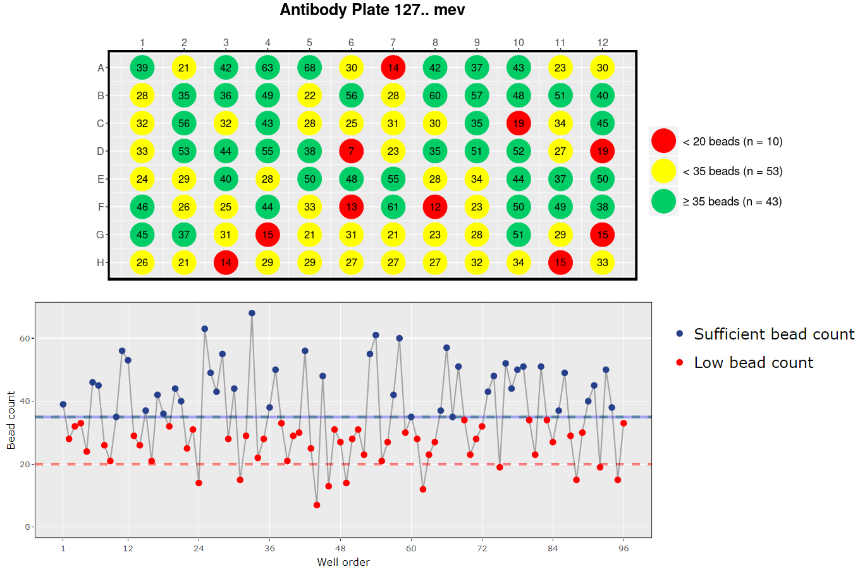
Problematic bead count example

Slide 13
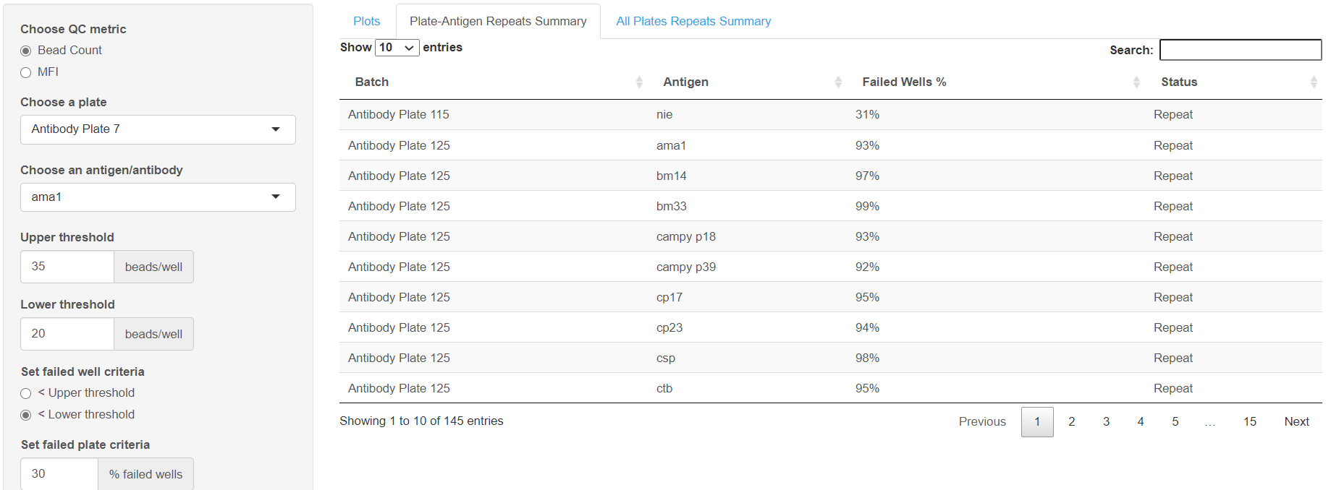
“Plate-Antigen Repeats Summary” tab contains an interactive data table of failed antigens for each batch.

Slide 14
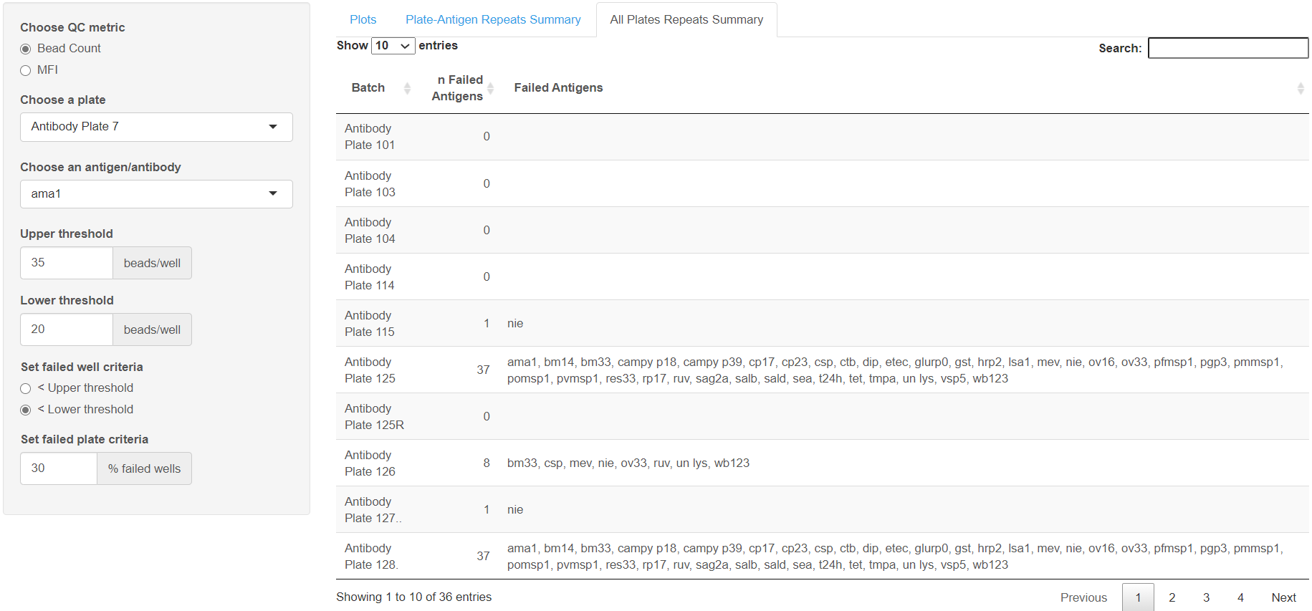
“All Plates Repeats Summary” tab contains a condensed interactive data table of failed antigens for each batch.

Slide 15
MFI QC

Slide 16
MFI QC
Helps to identify patterns of low MFI
Several factors may contribute to low MFI
missing secondary antibody
insufficient flushing with bleach prime

Slide 17
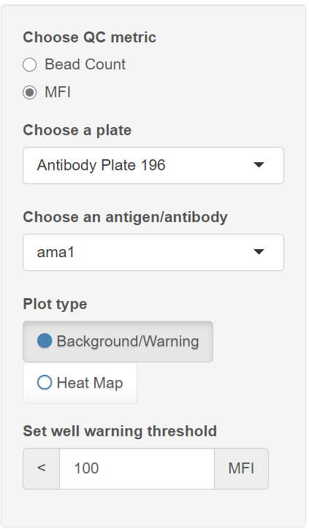
MFI QC: setting parameters
Click the “Bead Count / MFI” tab
Under “Choose QC metric” select “MFI”
Under “Choose a plate” and “Choose an antigen/antibody”, select which batch and antigen/antibody combination you’d like the app to display.
Choose which plot to display
Set the MFI warning threshold
Any wells with MFI under this value are flagged yellow

Slide 18
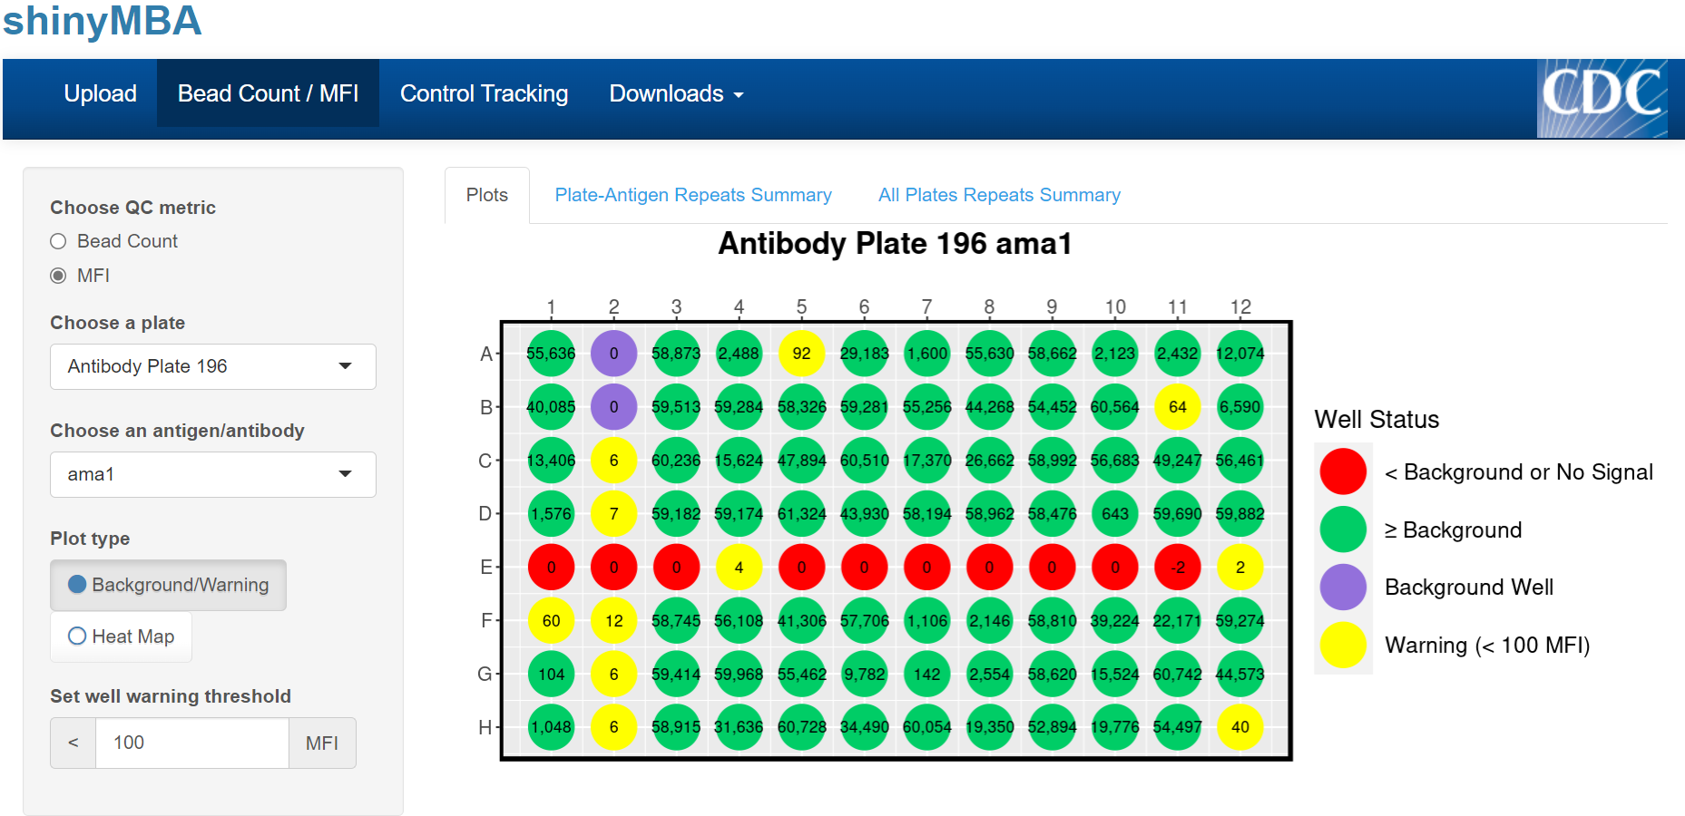
Suspicious
“Plots” tab displays a single 96-well plate plot with four color groups:
PURPLE: background well(s)
RED: MFI ≤ background MFI
YELLOW: MFI > background MFI, but < MFI warning threshold
GREEN: MFI > MFI warning threshold
“Plate-Antigen Repeats Summary” and “All Plates Repeats Summary” tabs do not display anything for MFI

Slide 19
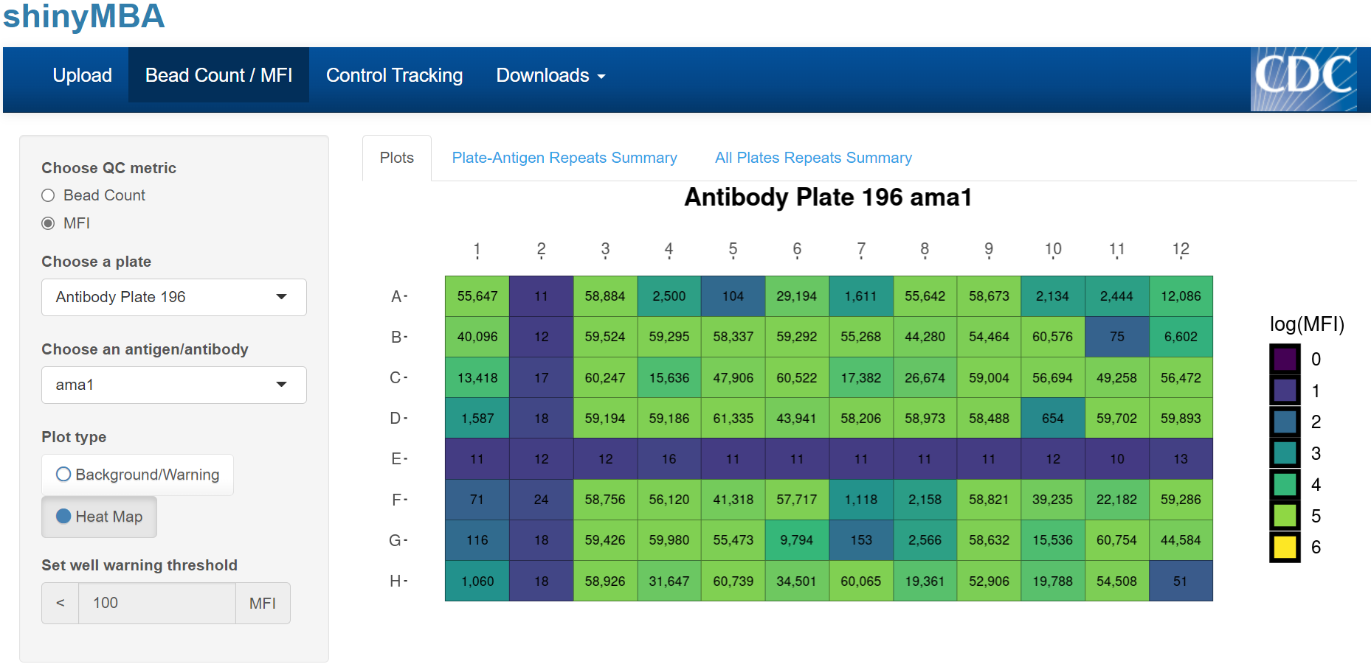
“Heat Map” displays a single 96-well plate plot with a color scale for log-transformed MFI and text displays for MFI.
MFI warning threshold is not applicable for this plot.
“Plate-Antigen Repeats Summary” and “All Plates Repeats Summary” tabs do not display anything for MFI.

Slide 20
Control Tracking
(xPONENT/BPM data source)

Slide 21
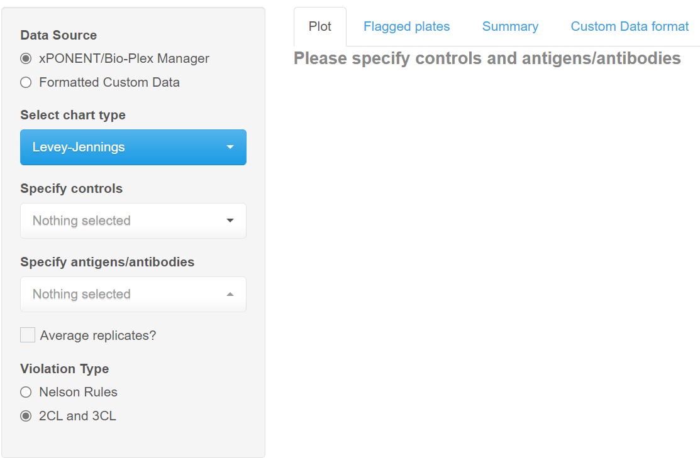
Control Tracking: xPONENT/BPM data
Click the “Control Tracking” tab
Under “Data Source” select “xPONENT/Bio-Plex Manager” to begin loading your data
Data may take several minutes to load

Slide 22
Control Tracking: xPONENT/BPM data
Click the “Control Tracking” tab
Under “Data Source” select “xPONENT/Bio-Plex Manager” to begin loading your data
This may take several minutes
Under “Select chart type”, select which process control chart you want to use.
Levey-Jennings, Shewhart, or Moving Range

Slide 23
Control Tracking: xPONENT/BPM data
Click the “Control Tracking” tab
Under “Data Source” select “xPONENT/Bio-Plex Manager” to begin loading your data
This may take several minutes
Under “Select chart type”, select which process control chart you want to use
Levey-Jennings, Shewhart, or Moving Range.
Under “Specify your controls” and “Specify antigens/antibodies”, select the sample ID’s that correspond to your controls and which antigens/antibodies your controls are relevant for

Slide 24
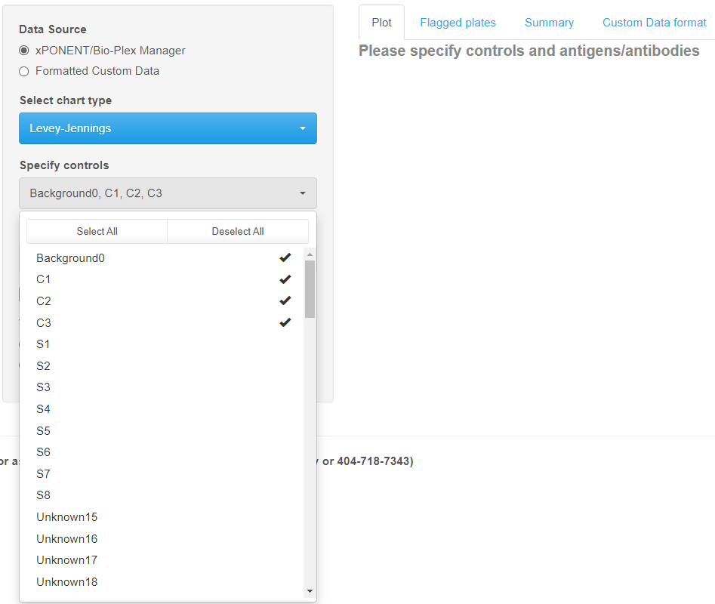
Control Tracking: xPONENT/BPM data
Click the “Control Tracking” tab
Under “Data Source” select “xPONENT/Bio-Plex Manager” to begin loading your data
This may take several minutes
Under “Select chart type”, select which process control chart you want to use
Levey-Jennings, Shewhart, or Moving Range.
Under “Specify your controls” and “Specify antigens/antibodies”, select the sample ID’s that correspond to your controls and which antigens/antibodies your controls are relevant for

Slide 25
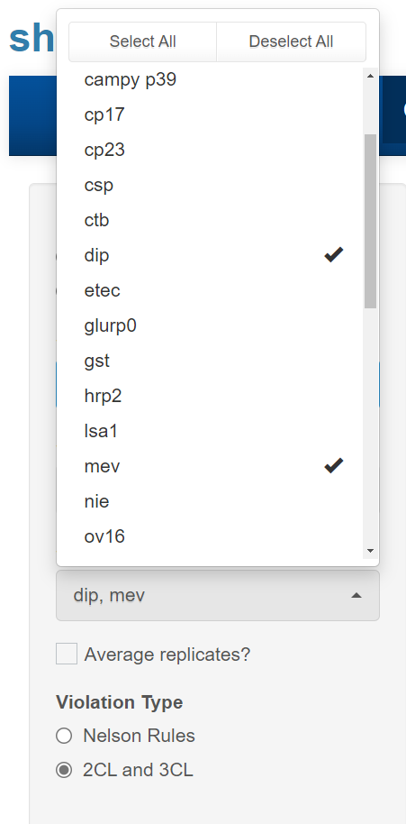
Control Tracking: xPONENT/BPM data
Click the “Control Tracking” tab
Under “Data Source” select “xPONENT/Bio-Plex Manager” to begin loading your data
This may take several minutes
Under “Select chart type”, select which process control chart you want to use
Levey-Jennings, Shewhart, or Moving Range.
Under “Specify your controls” and “Specify antigens/antibodies”, select the sample ID’s that correspond to your controls and which antigens/antibodies your controls are relevant for

Slide 26
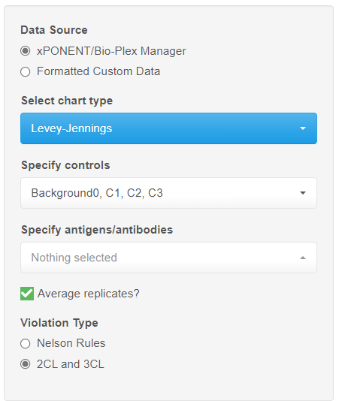
Control Tracking: xPONENT/BPM data
Click the “Control Tracking” tab
Under “Data Source” select “xPONENT/Bio-Plex Manager” to begin loading your data
This may take several minutes
Under “Select chart type”, select which process control chart you want to use
Levey-Jennings, Shewhart, or Moving Range.
Under “Specify your controls” and “Specify antigens/antibodies”, select the sample ID’s that correspond to your controls and which antigens/antibodies your controls are relevant for
Check “Average replicates?” if control replicates for each plate should be averaged before conducting LJ analyses
Under “Violation Type”, choose the criteria for out of control data points
Nelson Rules: set of 8 rules commonly used in control charts
2CL and 3CL: flags points falling outside of the 2σ or 3σ confidence limits

Slide 27
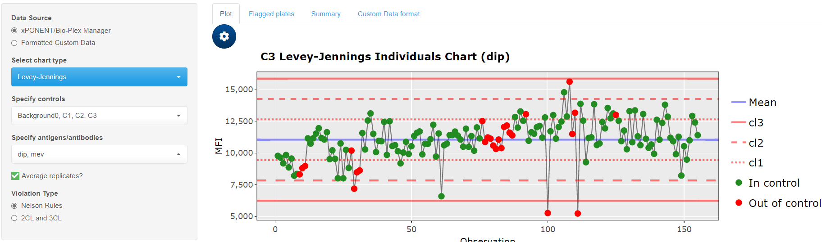
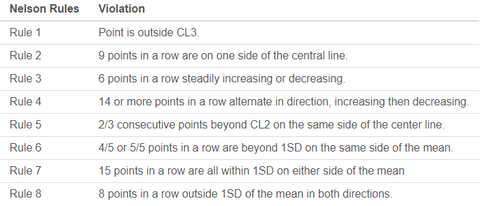

Slide 28
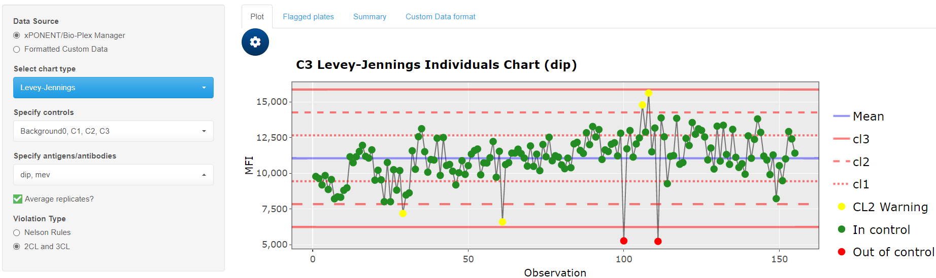

Slide 29
Change which plot is displayed here

Slide 30
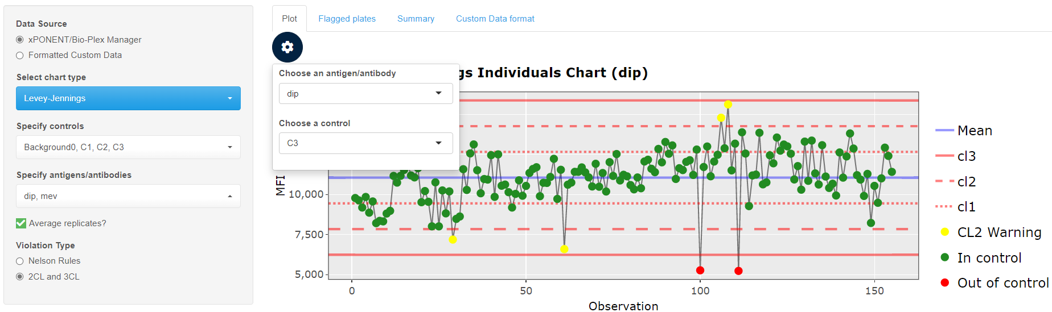

Slide 31
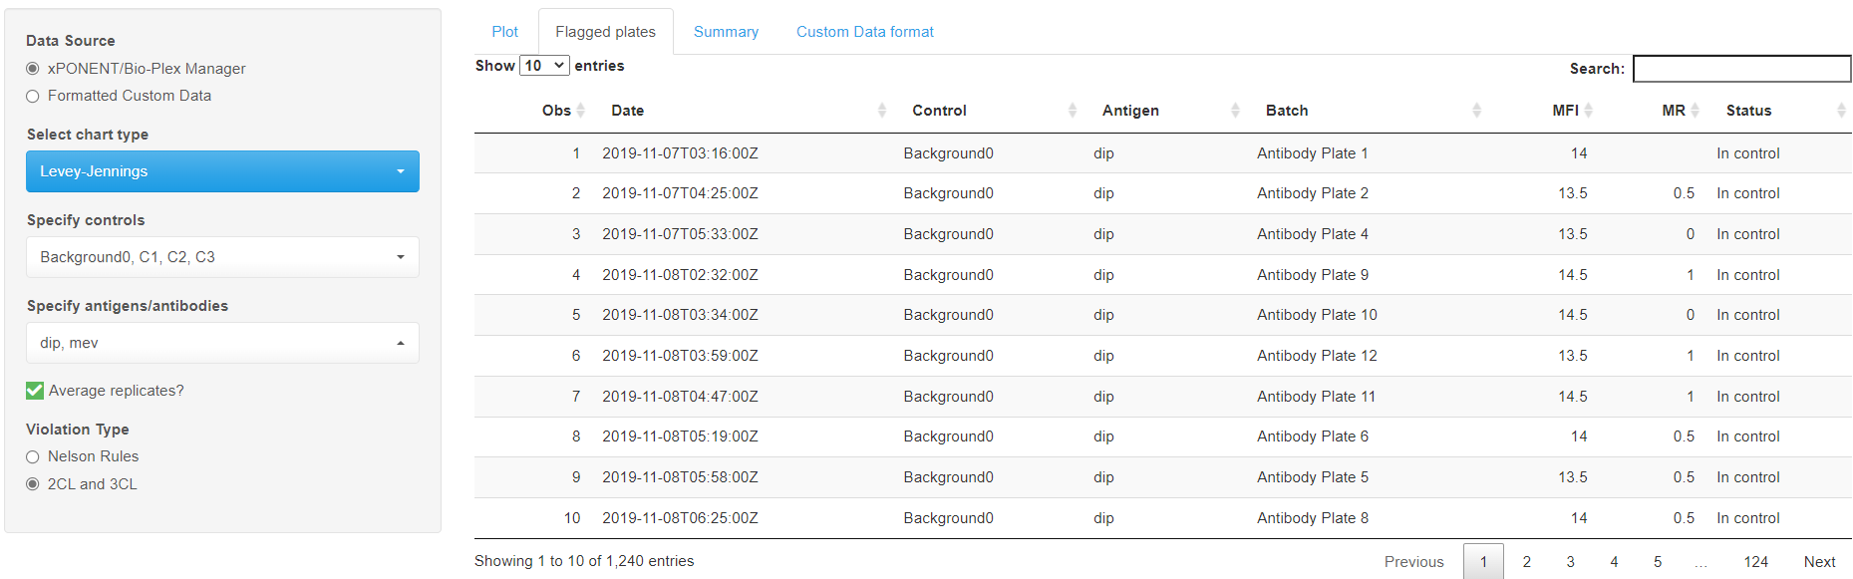
“Flagged Plates” tab contains a list of out of control data points
Shows out of control points for every antigen/antibody

Slide 32
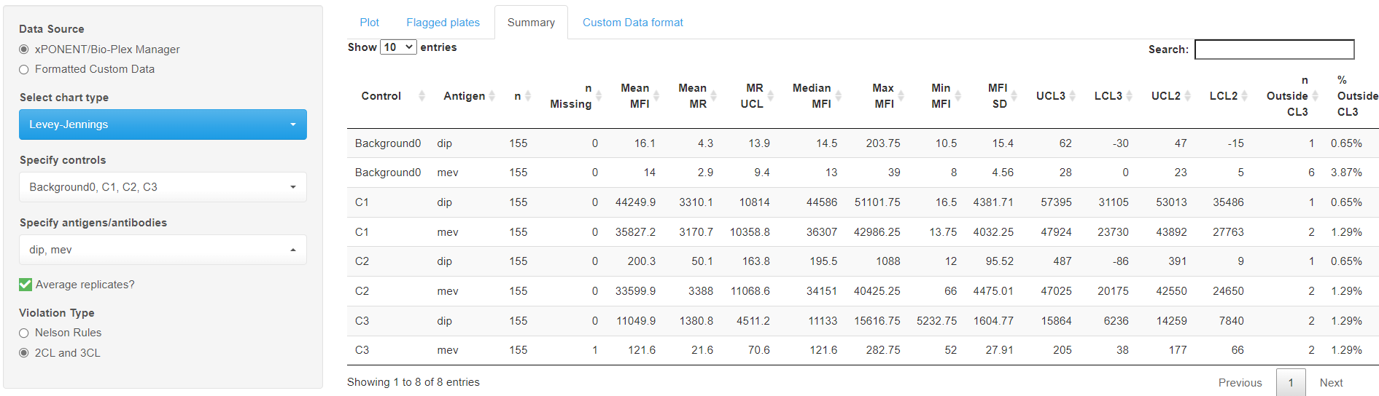
“Summary” tab contains a descriptive statistical summary table for every control and antigen/antibody combination

Slide 33
Control Tracking
(Custom data source)

Slide 34
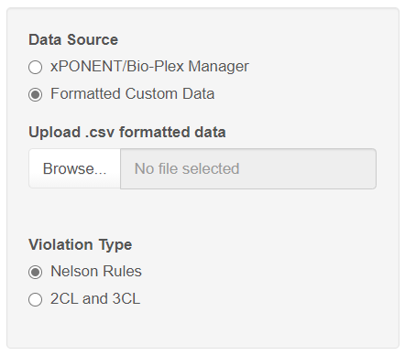
Control Tracking: Custom Data
Click the “Control Tracking” tab
Under “Data Source” select “Formatted Custom Data”

Slide 35
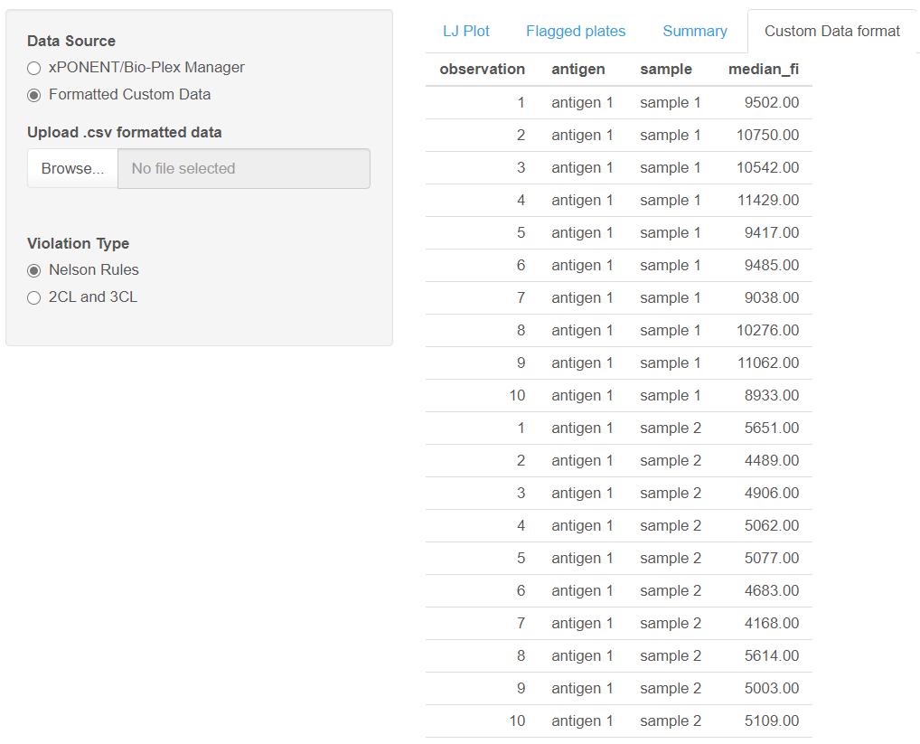
Control Tracking: Custom Data
Click the “Control Tracking” tab
Under “Data Source” select “Formatted Custom Data”
Ensure that your data is formatted correctly
An example of the proper format can be viewed under the “Custom Data format” tab.
Must be a four column .csv with variable names in the first row

Slide 36
Downloadable template

Slide 37
Control Tracking: Custom Data
Click the “Control Tracking” tab
Under “Data Source” select “Formatted Custom Data”
Ensure that your data is formatted correctly
An example of the proper format can be viewed under the “Custom Data format” tab.
Must be a four column .csv with variable names in the first row
Click “Browse…” to open the file explorer

Slide 38
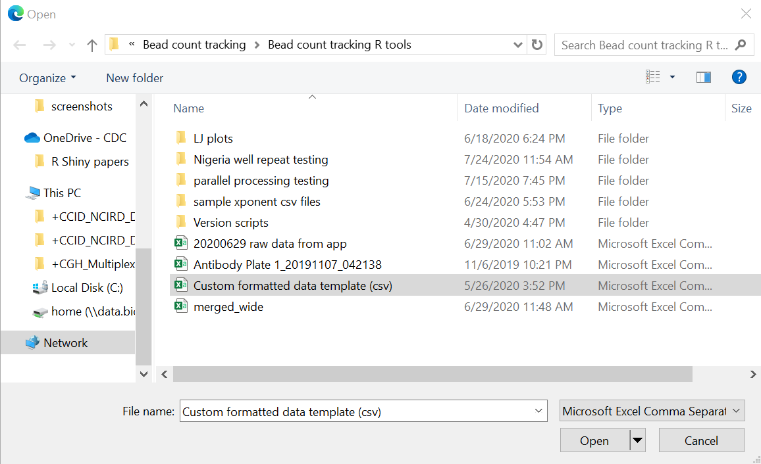
Control Tracking: Custom Data
Click the “Control Tracking” tab
Under “Data Source” select “Formatted Custom Data”
Ensure that your data is formatted correctly
An example of the proper format can be viewed under the “Custom Data format” tab.
Must be a four column .csv with variable names in the first row
Click “Browse…” to open the file explorer
Select your custom formatted .csv file and click “Open”

Slide 39
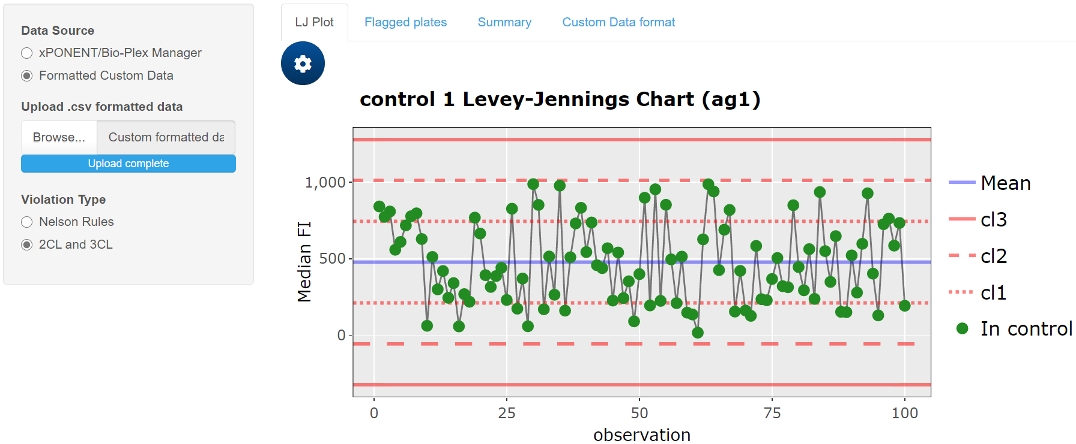
Same features are available for both xPONENT/BPM and custom formatted data.

Slide 40
Downloading Output

Slide 41

Make sure you have set all the parameters in the “Bead Count/MFI” and “Control Tracking” modules before downloading anything!

Slide 42
Downloading Output
Click the “Downloads” tab

Slide 43
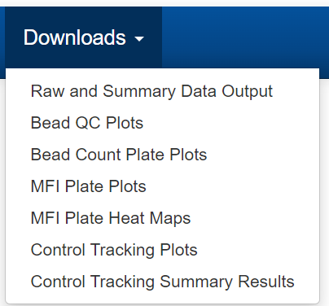
Downloading Output
Click the “Downloads” tab
From the drop-down menu, select which output you want to download

Slide 44
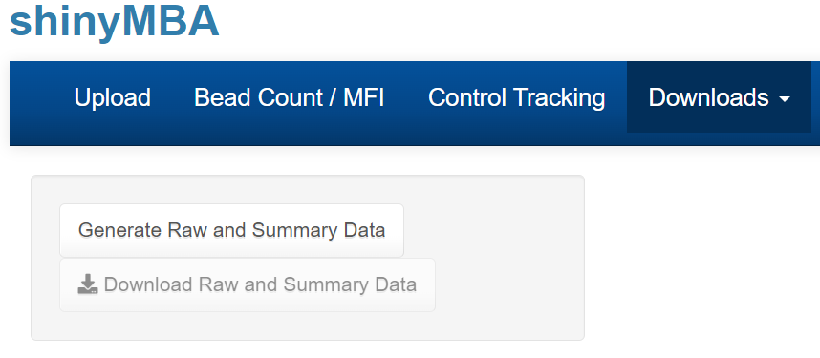
Downloading Output
Click the “Downloads” tab
From the drop-down menu, select which output you want to download.
Click the “generate” button to initiate the download

Slide 45
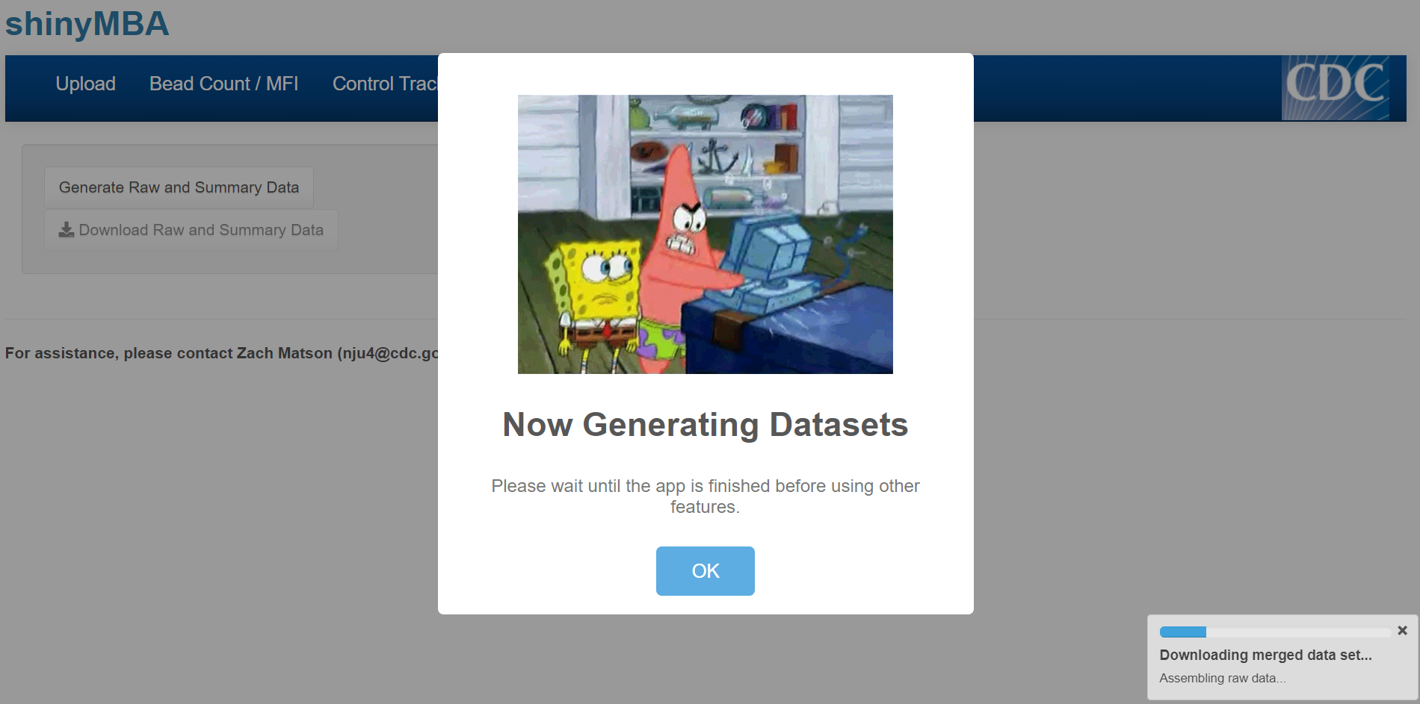
Downloading Output
Click the “Downloads” tab
From the drop-down menu, select which output you want to download.
Click the “generate” button to initiate the download
A window and progress bar will appear. Wait until a confirmation window appears before using other part of the app.

Slide 46
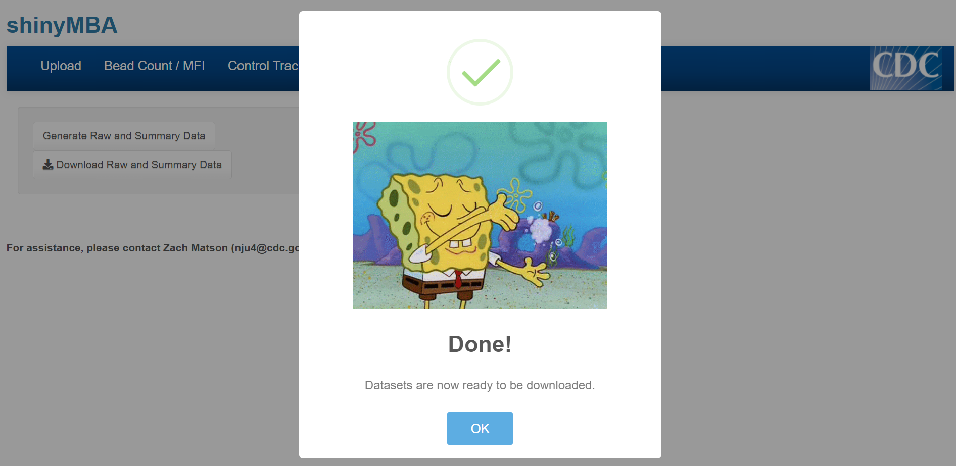
Downloading Output
Click the “Downloads” tab
From the drop-down menu, select which output you want to download.
Click the “generate” button to initiate the download
A window and progress bar will appear. Wait until a confirmation window appears before using other part of the app.

Slide 47
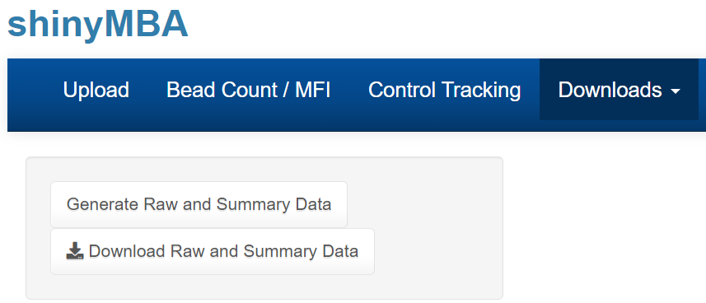
Downloading Output
Click the “Downloads” tab
From the drop-down menu, select which output you want to download.
Click the “generate” button to initiate the download
A window and progress bar will appear. Wait until a confirmation window appears before using other part of the app.
Click the “download” button to save the output

Slide 48
Types of Downloadable Output

Slide 49
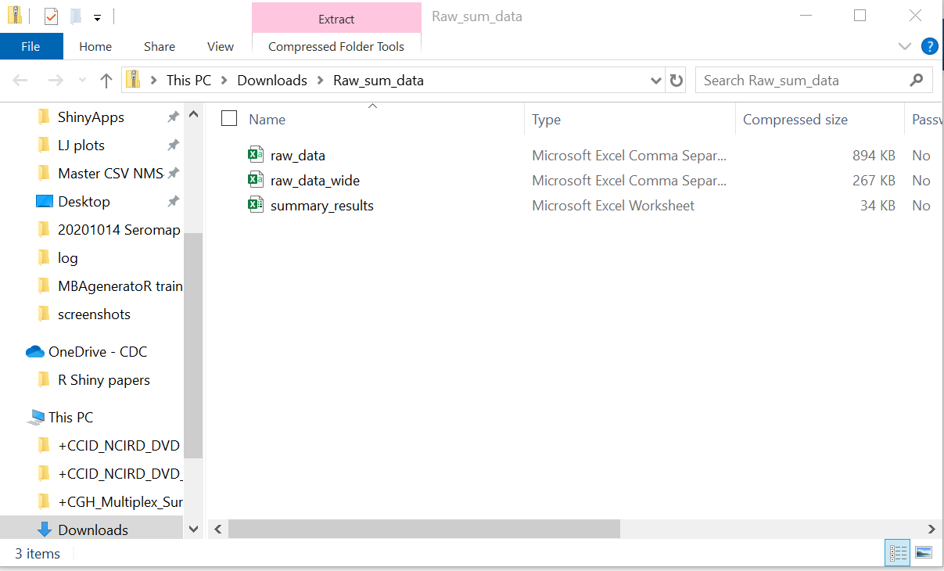
Merged datasets and bead count QC summary tables

Slide 50
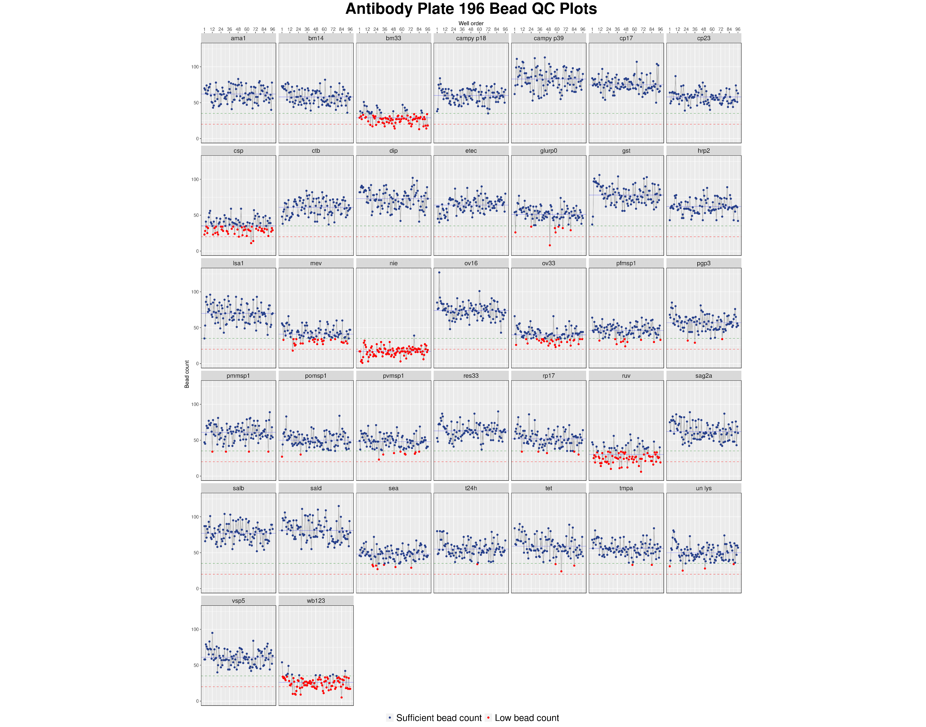
Bead count fluctuation plots
One plot for each plate with facets for every antigen/antibody

Slide 51
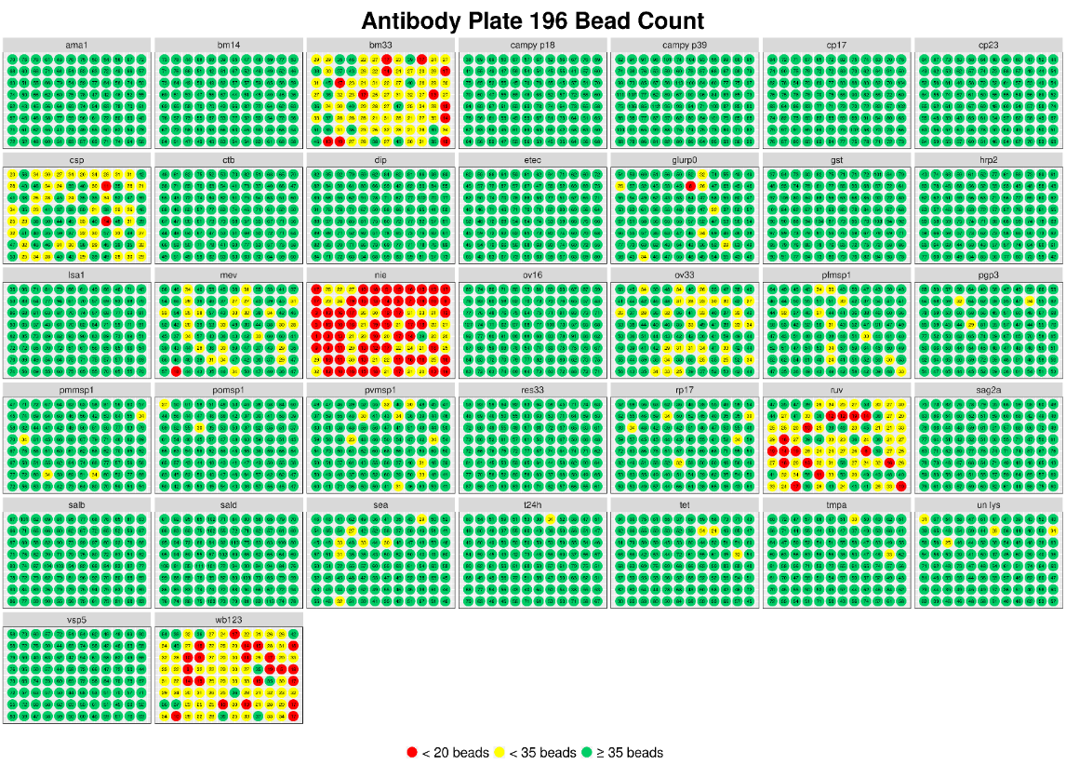
Bead count 96-well plate plots
One plot for each plate with facets for every antigen/antibody

Slide 52
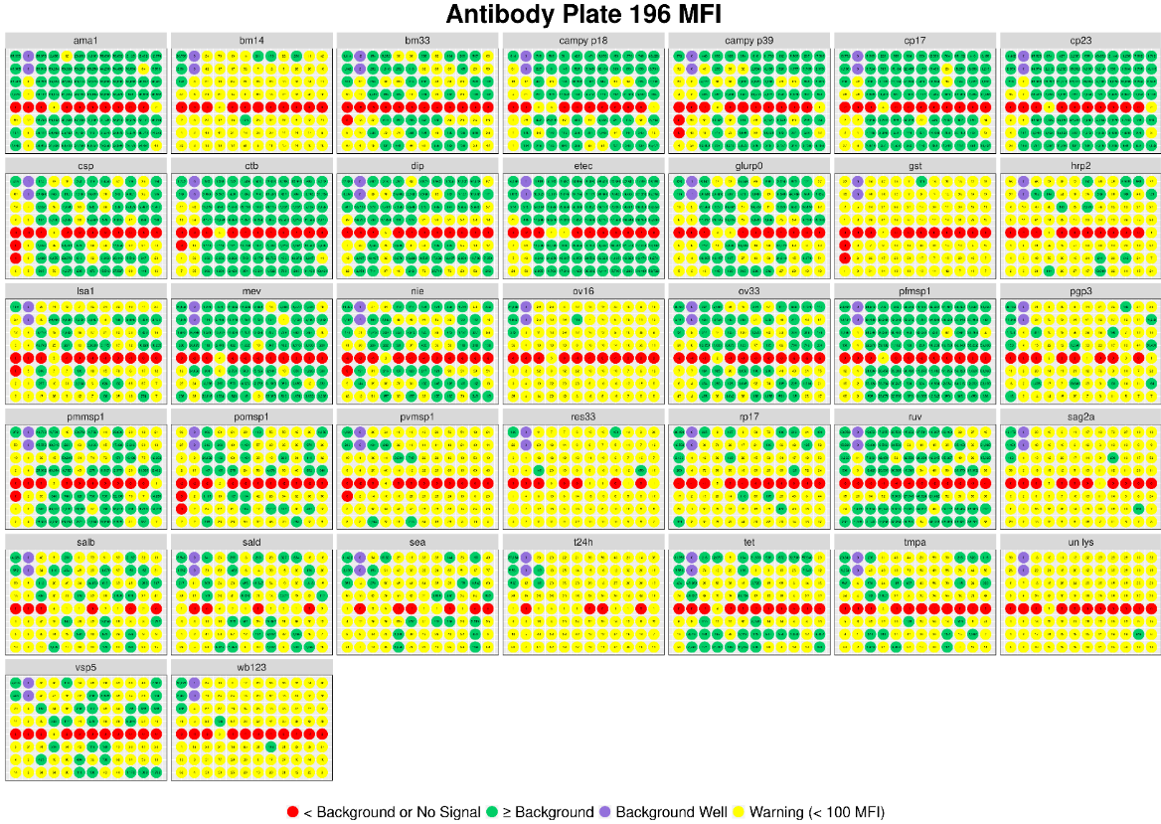
MFI 96-well plate plots
One plot for each plate with facets for every antigen/antibody

Slide 53
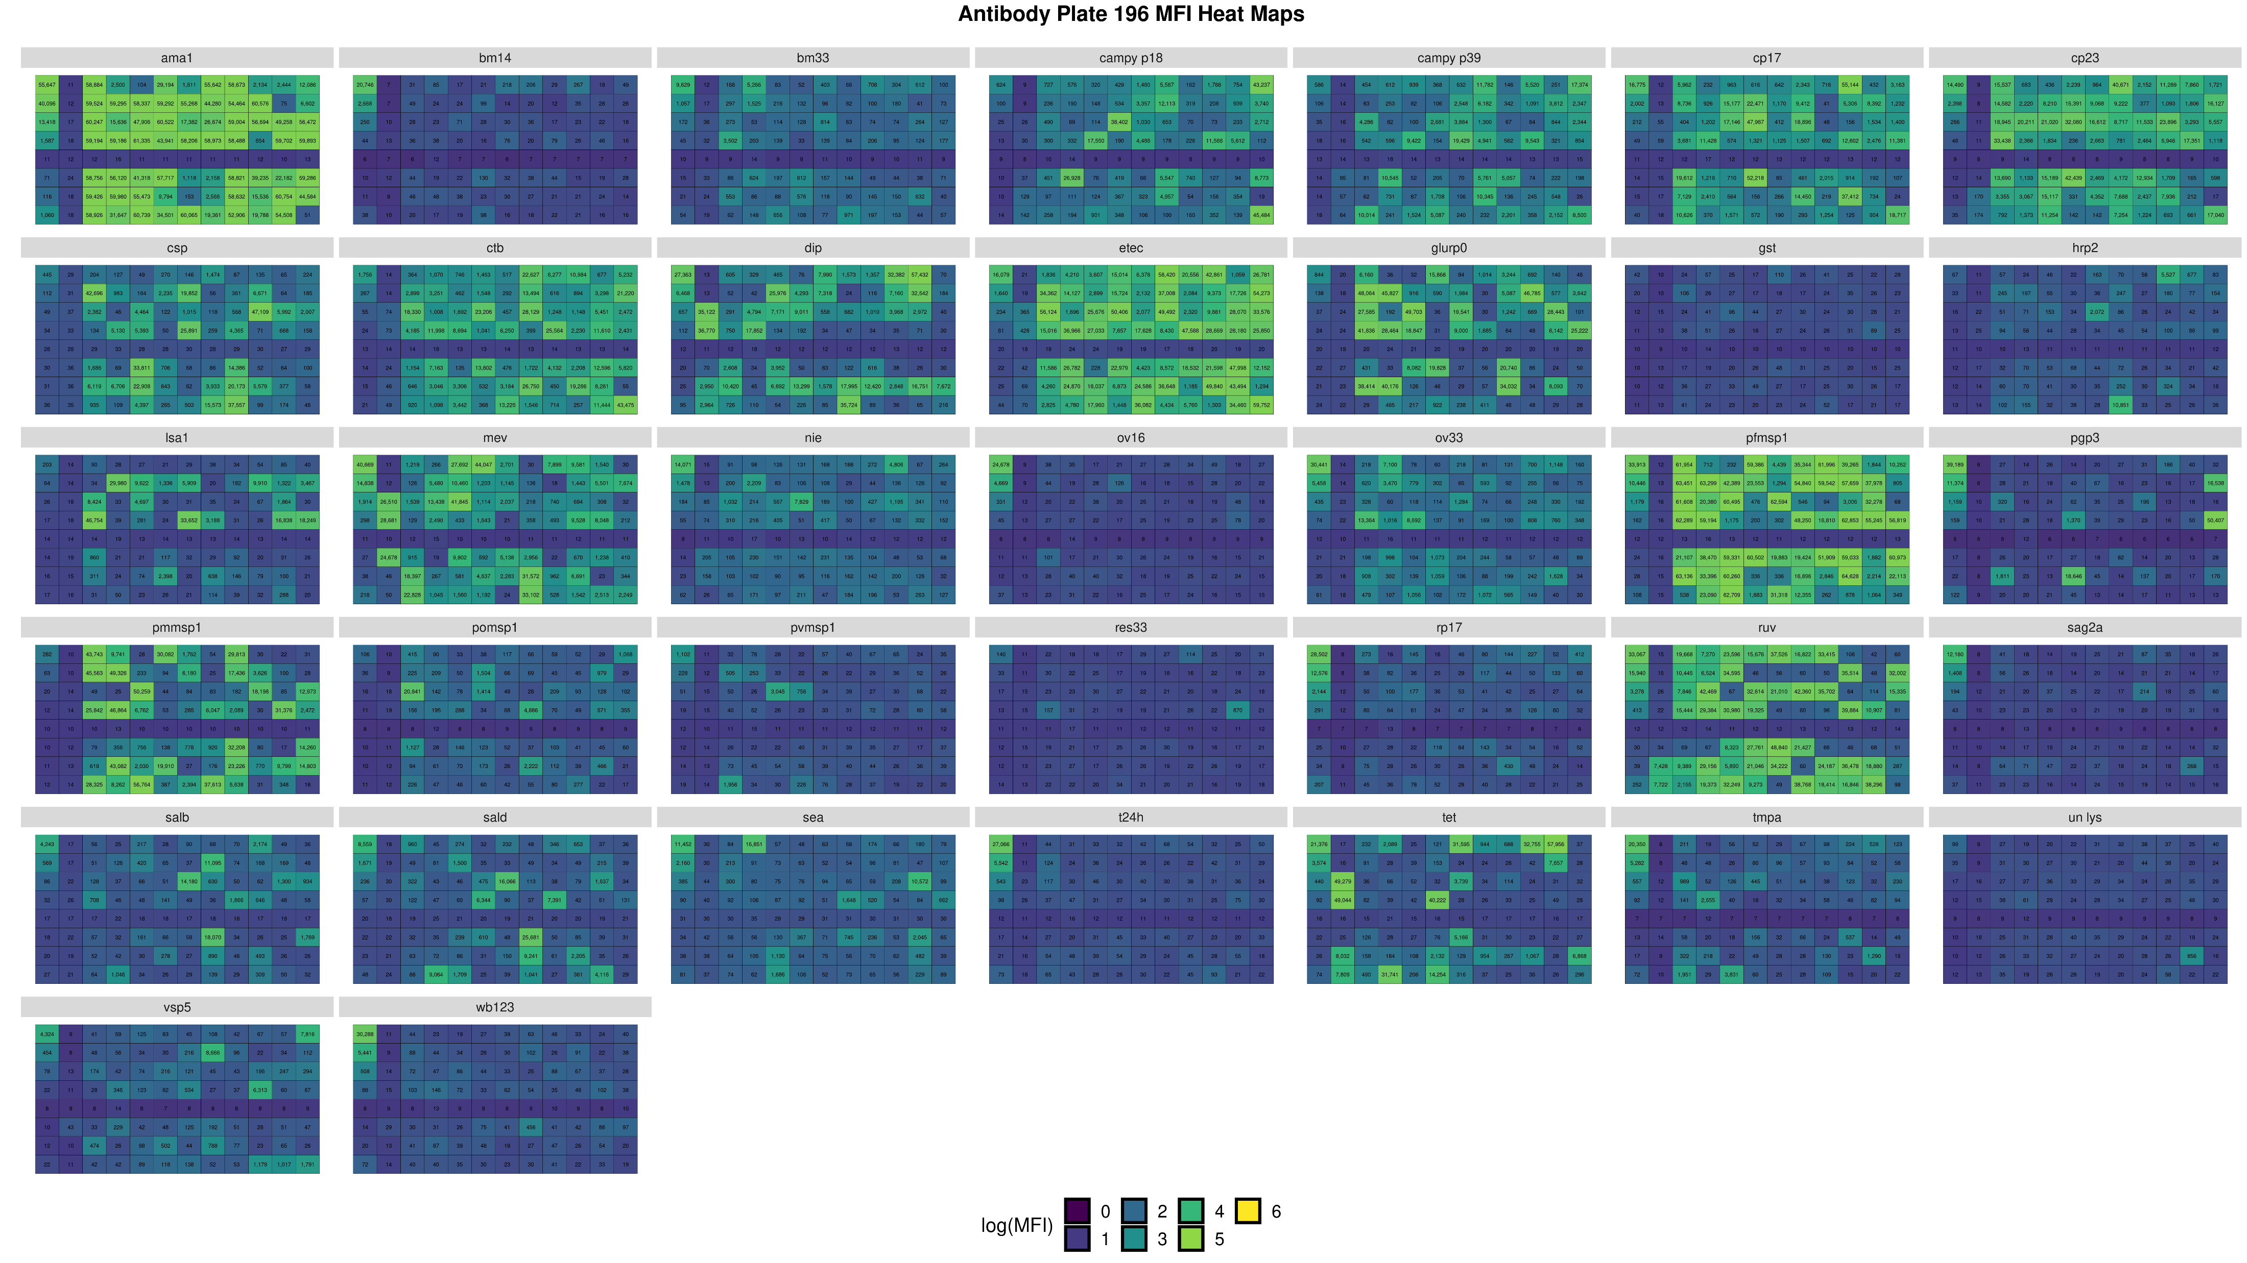
Log(MFI) 96-well heat maps
One plot for each plate with facets for every antigen/antibody

Slide 54
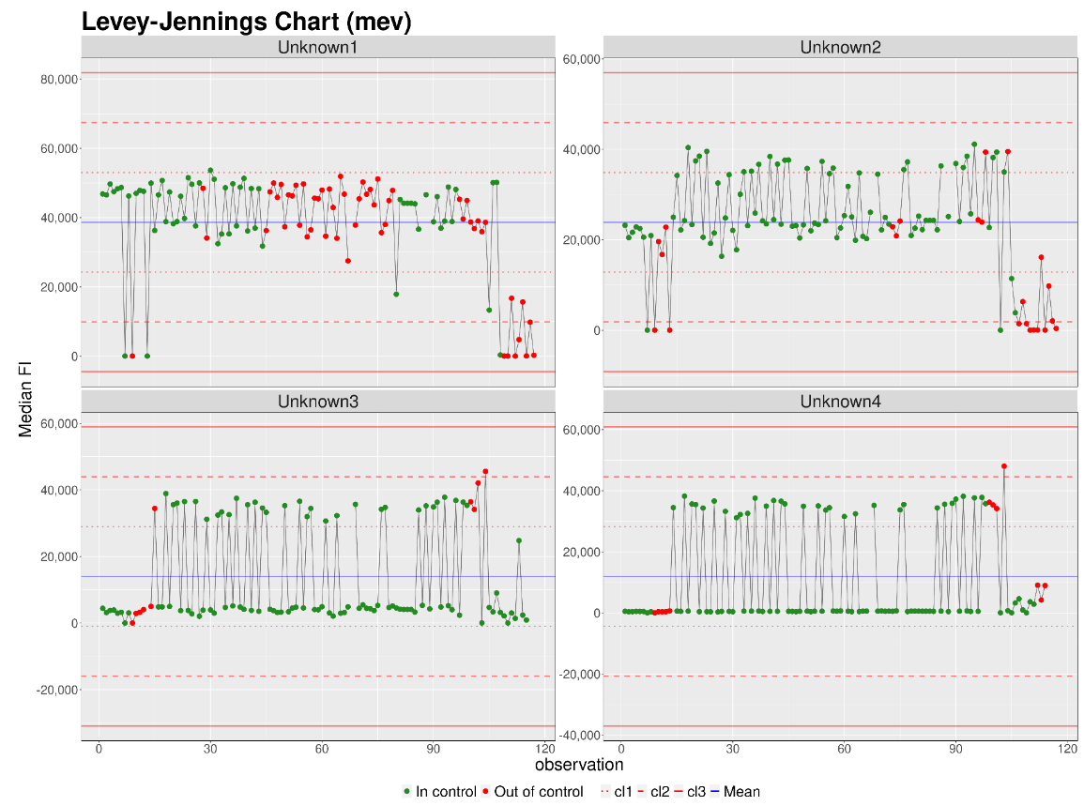
Control Process charts
One plot for each antigen/antibody with facets for every control

Slide 55
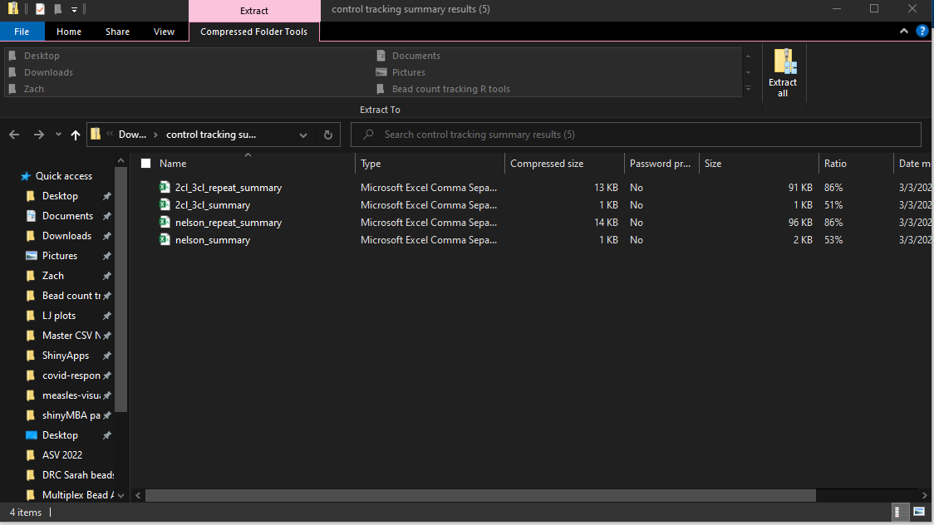
Levey-Jennings summary tables
Contains both Nelson rules and 2CL-3CL results

